Slide 1
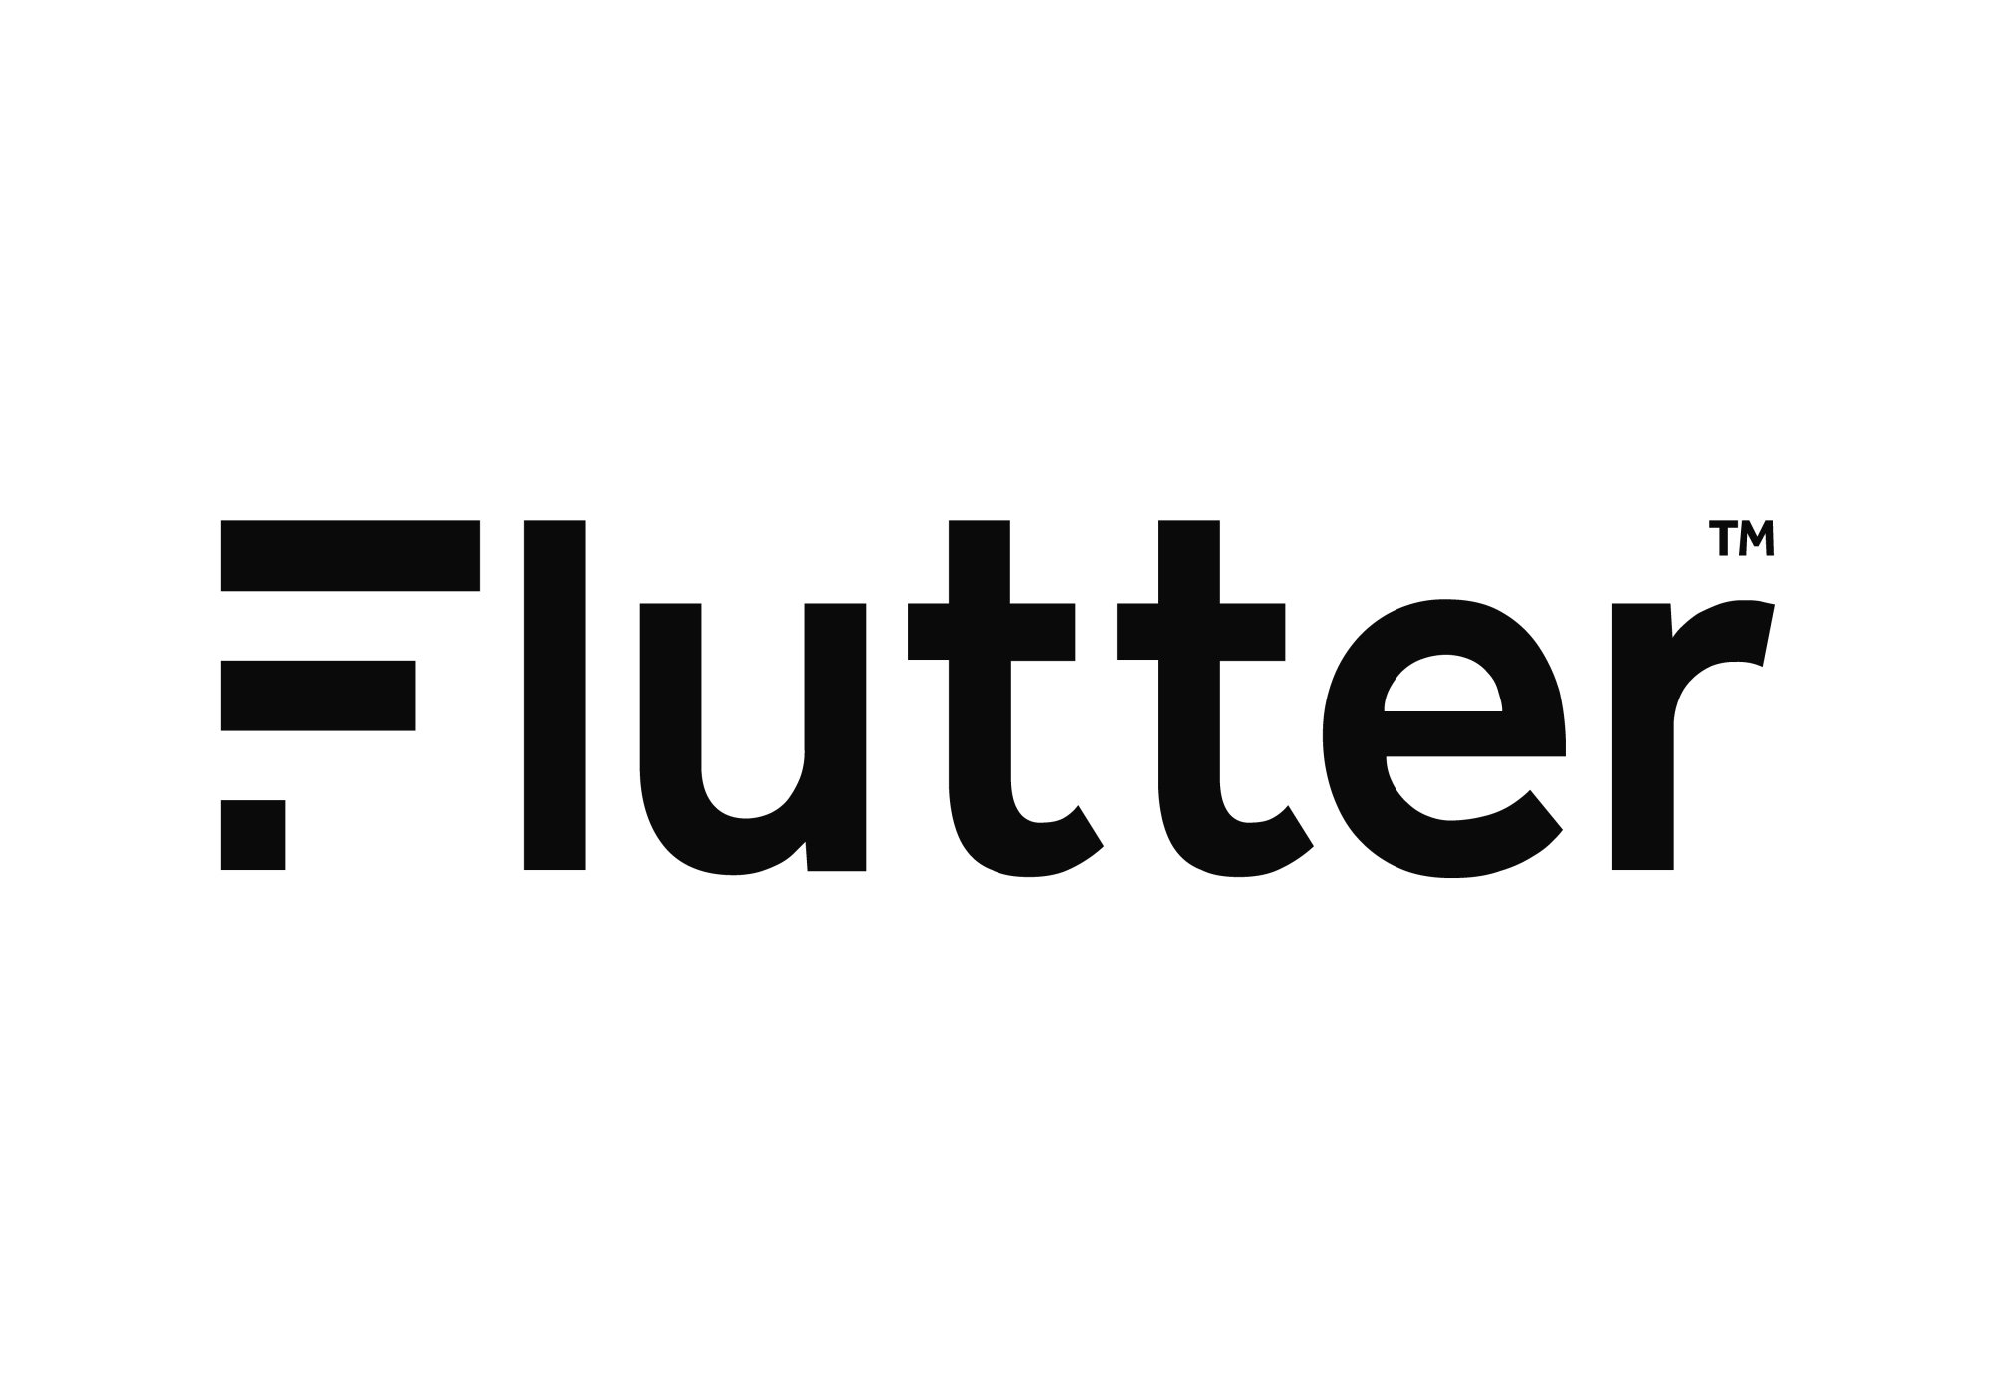
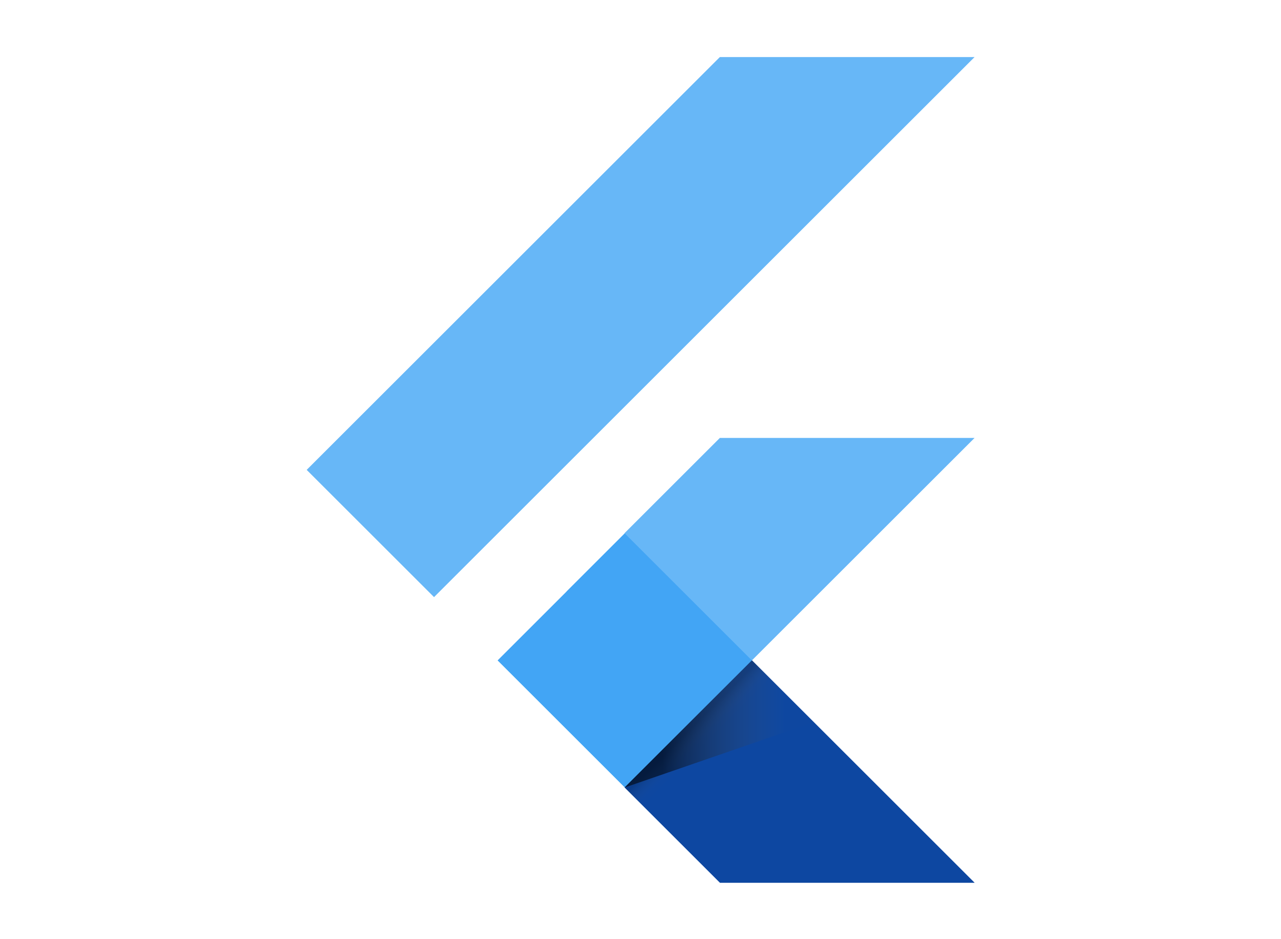
Mastering Flutter: From Beginner to Pro.
joeshwoa.george@gmail.com
Session 6: Introduction to Native Mobile VS Cross-Platform Development

Slide 2
Do not skip any information without understanding it.
joeshwoa.george@gmail.com
― Joeshwoa George

Slide 3
Any questions?
joeshwoa.george@gmail.com
Don;t forget study this section well and write your questions in note and i will answer it in live session.

Slide 4
Table of Contents.
Overview of Android Development (Kotlin)
Overview of iOS Development (Swift)
Introduction to Cross-Platform Development
Q&A and Wrap-Up
01
02
Introduction to Android Development.
Introduction to iOS Development.
03
04
Flutter, React Native, Benefits.
Let's ask
joeshwoa.george@gmail.com

Slide 5
Overview of Android Development (Kotlin).
01
Let’s Start with
Introduction to Android Development
joeshwoa.george@gmail.com

Slide 6
Introduction to Android Development
Android is the most widely used mobile operating system, developed by Google.
Apps are primarily built using Kotlin or Java.
joeshwoa.george@gmail.com

Slide 7
Kotlin Overview
Modern, concise, and safer than Java.
Fully interoperable with Java.
Key features:
null safety
extension functions
coroutines
joeshwoa.george@gmail.com

Slide 8
Android Development Basics
Development Tools:
Android Studio (IDE for Android development).
Android Virtual Device (AVD) for testing apps.
Components of an Android App:
Activities: Entry points for user interaction.
Fragments: Modular sections of a UI.
Services: Background processing components.
XML for layouts.
joeshwoa.george@gmail.com

Slide 9
Example: Hello World in Kotlin
import androidx.appcompat.app.AppCompatActivity
import android.os.Bundle
import android.widget.TextView
class MainActivity : AppCompatActivity() {
override fun onCreate(savedInstanceState: Bundle?) {
super.onCreate(savedInstanceState)
val textView = TextView(this)
textView.text = "Hello, Android!"
setContentView(textView)
}
}
joeshwoa.george@gmail.com

Slide 10
Overview of iOS Development (Swift).
02
Let’s Start with
Introduction to iOS Development
joeshwoa.george@gmail.com

Slide 11
Introduction to iOS Development
iOS is the mobile operating system developed by Apple.
Apps are built using Swift or Objective-C.
joeshwoa.george@gmail.com

Slide 12
Swift Overview
A modern, fast, and safe programming language created by Apple.
Readable syntax, dynamic libraries, and fast performance.
joeshwoa.george@gmail.com

Slide 13
iOS Development Basics
Development Tools:
Xcode (IDE for iOS development).
Simulator for testing iOS apps.
Components of an iOS App:
View Controllers: Manage screens in the app.
Storyboards: Visual layout editor for UI.
SwiftUI: Declarative framework for building UIs (modern alternative to UIKit).
joeshwoa.george@gmail.com

Slide 14
Example: Hello World in Swift
import UIKit
class ViewController: UIViewController {
override func viewDidLoad() {
super.viewDidLoad()
let label = UILabel()
label.text = "Hello, iOS!"
label.textAlignment = .center
label.frame = view.bounds
view.addSubview(label)
}
}
joeshwoa.george@gmail.com

Slide 15
Introduction to Cross-Platform Development.
03
Let’s Start with
What is Cross-Platform Development?
joeshwoa.george@gmail.com

Slide 16
What is Cross-Platform Development?
Building apps that run on multiple platforms (Android, iOS, Web, etc.) with a single codebase.
Popular frameworks include Flutter and React Native.
joeshwoa.george@gmail.com

Slide 17
Flutter Overview
Developed by Google.
Uses Dart programming language.
Features:
Widget-based UI system.
High performance through its Skia rendering engine.
Rich ecosystem of libraries and plugins.
joeshwoa.george@gmail.com

Slide 18
React Native Overview
Developed by Facebook.
Uses JavaScript and React.
Features:
Hot reloading for instant feedback.
Native modules for performance-critical tasks.
joeshwoa.george@gmail.com

Slide 19
Benefits of Cross-Platform Development
Advantages
Single Codebase: Write once, deploy to multiple platforms.
Faster Development: Reduced time and cost.
Consistency: Uniform look and feel across platforms.
Community and Libraries: Large community and extensive libraries.
joeshwoa.george@gmail.com

Slide 20
Benefits of Cross-Platform Development
Use Cases
Startups or businesses with limited budgets and resources.
Apps with simple or moderate performance requirements. (NOT NOW)
joeshwoa.george@gmail.com

Slide 21
Q&A and Wrap-Up.
04
Let’s Start with
Any questions in this session?
joeshwoa.george@gmail.com

Slide 22
Homework
Install Flutter SDK and create a simple "Hello World" app in Flutter.
Share the screenshot of your app running on an Android or iOS emulator.
joeshwoa.george@gmail.com

Slide 23

OFFFFF Take a brack.
joeshwoa.george@gmail.com
Only Koalas don’t have much energy and, Koala can sleep for up to 18 hours a day but you only need 6-8 hours to have all energy needed energy for one day.

Slide 24
So, Don’t Wast Your Time in Sleep.
joeshwoa.george@gmail.com
― Joeshwoa George

Slide 25
See you next session!
joeshwoa.george@gmail.com
Don;t forget study this section well and write your questions in note and i will answer it in live session.

Slide 26

Thank you!
Do you have any questions?
joeshwoa.george@gmail.com
+20 120 294 6596
joeshwoa.george@gmail.com

